Slide 1
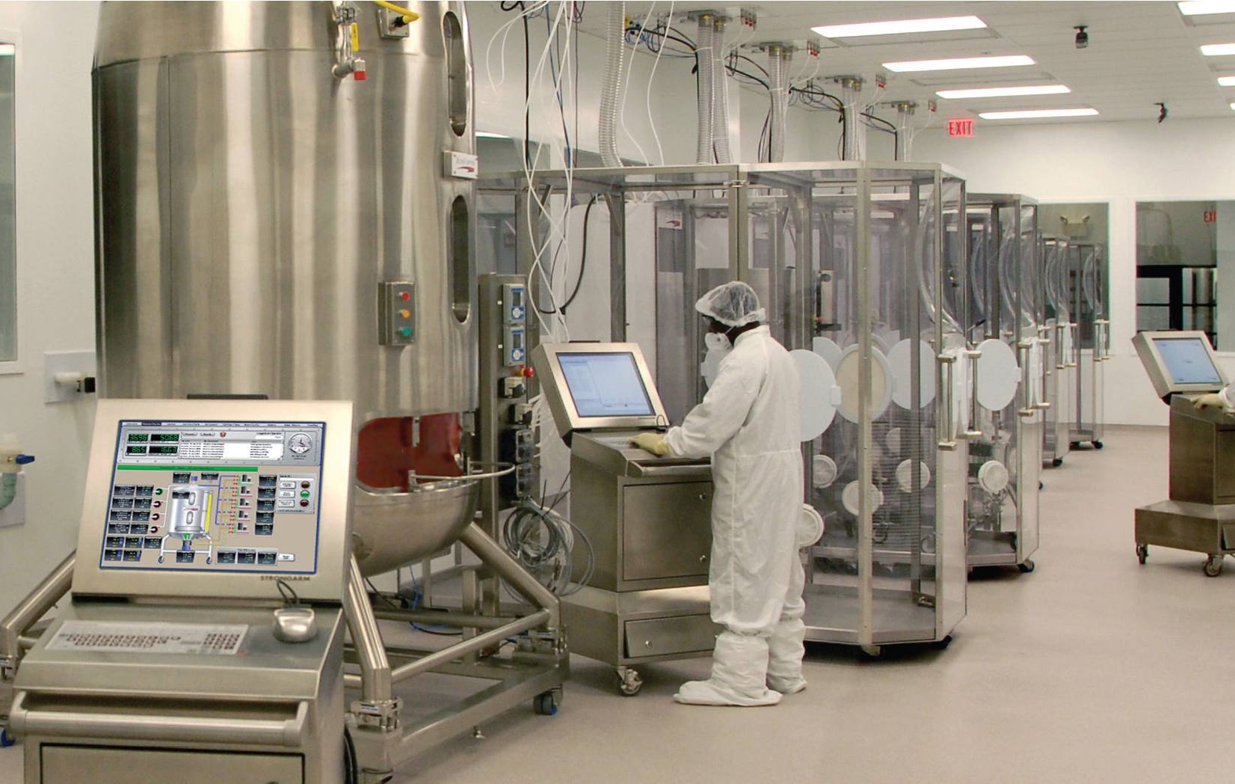
Xcellerex
Marlborough, Massachusetts
Goals
Address the growing demands in the biomedical market space for more effective biopharmaceutical manufacturing processes
Develop a solution that would define a model for improving how biopharmaceuticals, vaccines and other therapeutics are developed, manufactured and commercialized
Challenges
Integrating complex technology with ultra-high levels of functionality was considered the greatest challenge in creating a biomanufacturing platform that employs a single-use technology, controlled environment modules, process automation and electronic batch records
Results
Xcellerex’s FlexFactory achieves significant cost savings, including a capital investment reduction that can exceed 60 percent
Reduces deployment time from three to five years to 12 to 18 months
The solution achieves an overall reduction in development time of nearly 60 percent, with an estimated 80 percent saving in rework time
Industry: Life Sciences
Products: System Platform | InTouch HMI (Standard Edition) | Batch Management | Historian
“We’ve been able to reduce deployment time from 3-5 years to an amazing 12-18 months. This results in huge implementation savings and the ability to begin producing high value product 2 to 4 years sooner than traditional technology.”
John A. Chickosky, Chief Commercial Officer and President, Biosystems
LEARN MORE

