Slide 1
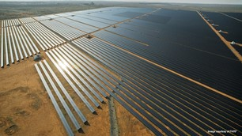
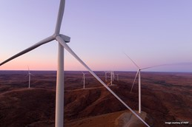
AGL Energy
Australia
Securely sharing real-time power generation data with partners, optimizing usage across distributed power generation sites and saving thousands annually in personnel hours.
Challenges
Optimize relationships and collaboration for partner sites managed by AGL, replacing manual processes and static data capture, with real-time dynamic data.
Build cost-saving, innovative sustainability and efficiency features into multi-sourced and distributed power generation projects; optimize metrics to align with ESG priorities.
Enhance site visibility and efficiency with secure, shared insight into energy and power generation and asset utilization, optimizing usage and mitigating costs and potential critical outages.
Results
Secure wind and solar generation data successfully is shared in the cloud with authorized (partner) users in remote locations, leveraging existing internet infrastructure.
Real-time and dynamic data access enables secure collaboration and remote work for external partners, who previously obtained static reports on their renewable assets.
Estimated ~AUD$7,000 savings in personnel hours annually with one partner and ~AUD$28,000 with three additional partners.
Industry: Power generation
Solution: AVEVA Data Hub (formerly OSIsoft Cloud Services)
“AGL Energy are excited to be leveraging AVEVA Data Hub to deliver a new standard in collaboration and real-time data transparency within our renewable utility network. Newfound insights into energy and power generation are helping us enhance site efficiency and asset utilization, while mitigating costs and potential critical outages. We anticipate significant in-person savings in the first year and look forward to leveraging our competitive advantage to provide similar value to our diverse power generation portfolio.”
David Bartolo, Head of Asset Intelligence, AGL

