Slide 1
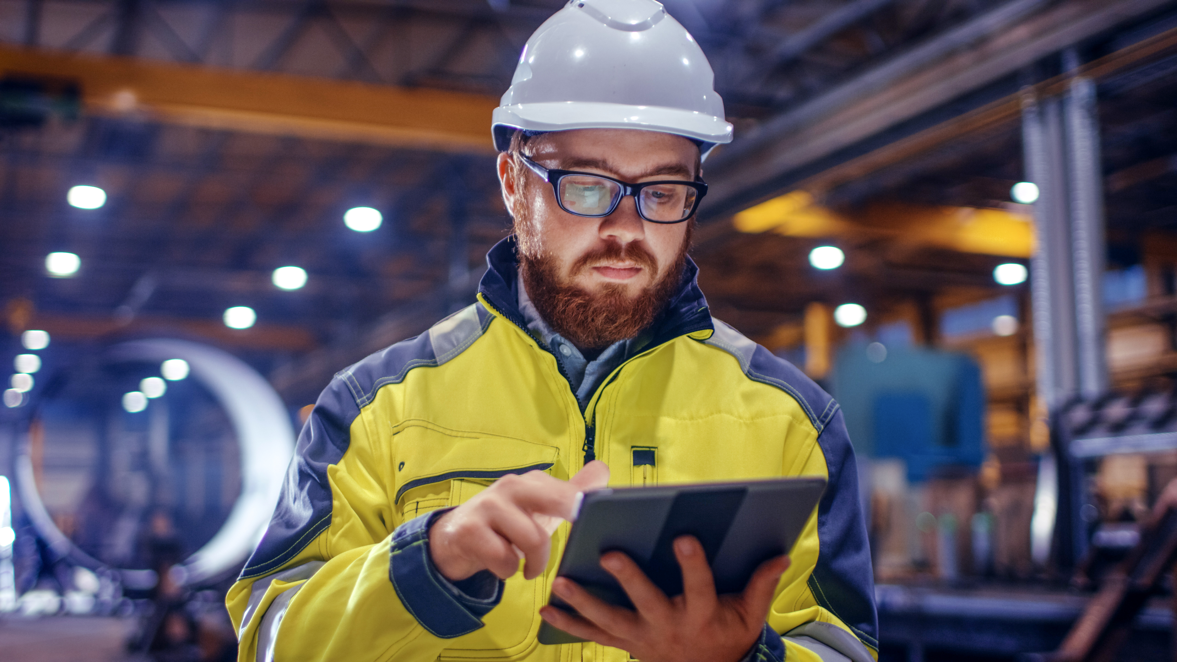
Italpresse Gauss
Italy
First-of-its-kind remote maintenance solution is based on AVEVA’s AV/VR platforms
Goals
  Develop a custom HMI that operates with other OEM devices and software platforms
  Incorporate AR/VR technologies as an asset performance and remote support tool
  Support the company’s leadership position in Industrie 4.0
Challenges
  Introduce Industrie 4.0 technologies to the aluminum foundry industry
  Leverage breakthrough AR/VR technology to pilot new asset performance management and operator training solutions
  Deliver new concepts to market on an aggressive timeline
Results
  Delivered an open interface HMI architecture that communicates with other devices, collects data on a local SQL server database, and improves situational awareness
  Reinvented the concept of asset maintenance and support for the captive foundry industry
  Tapped into completely new revenue streams by embedding AVEVA’s open, flexible platforms into its machines
Industry: OEMs & Machine Builders
Solution: AVEVA™ XR for Training, AVEVA™ System Platform, AVEVA™ InTouch HMI,
“What is being consolidated is the capability to provide support for maintenance, support for troubleshooting, and support for remote controlling of the machine.”
Carlo Scalmana, President, Italpresse Gauss
LEARN MORE

